Slide 1
Static Analysis for Android Applications to
Detect Protected Health Information (PHI)
and Analyze Intent Relationship
Ashfak Md Shibli
Tahiatul Islam

Slide 2
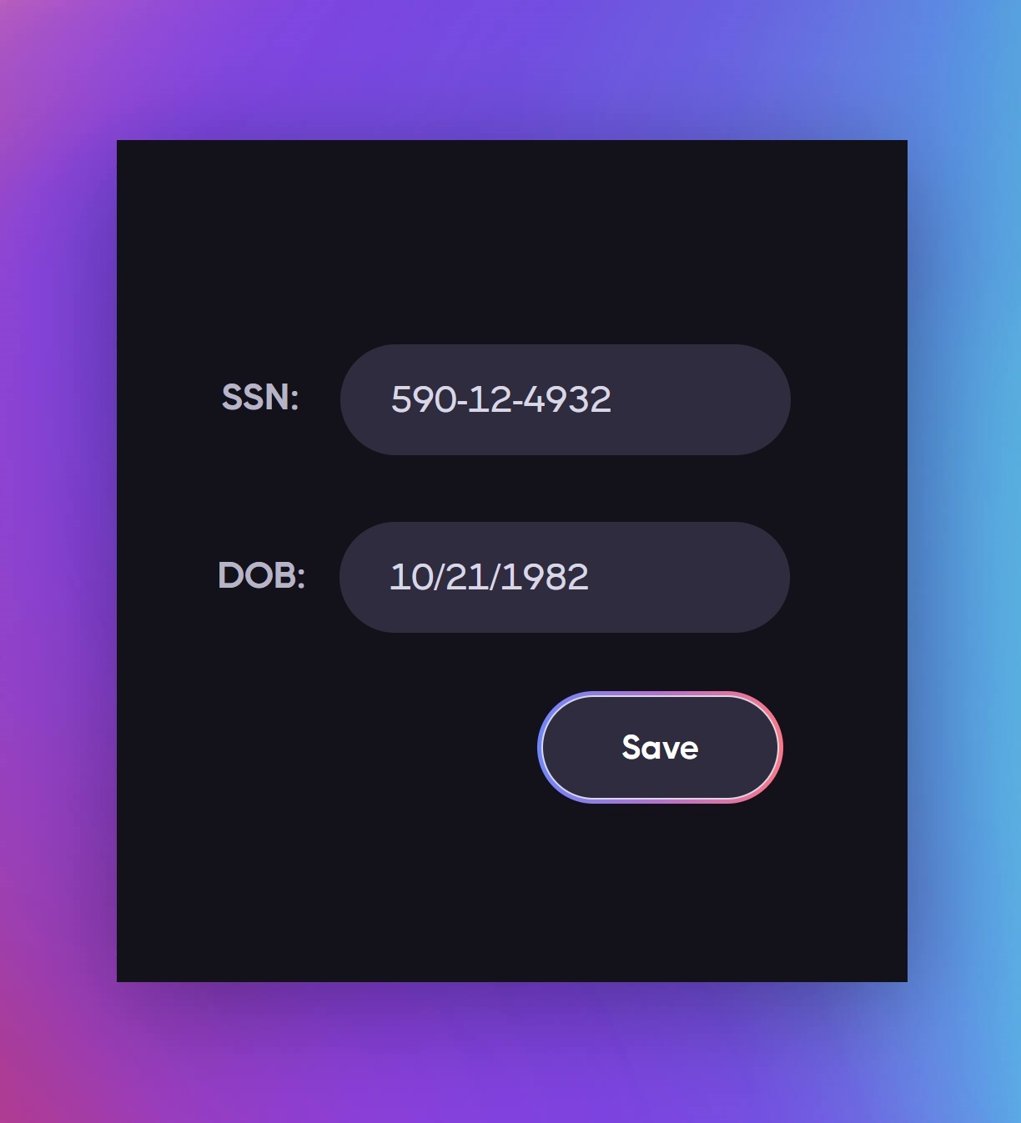

Everything secure?
We think we are.
But there can be potential leak.
This makes things vulnerable.
Like giving data to attacker.
Same goes for data in the Apps.
Source: Starc
Source: pinterest

Slide 3
Why Bother PHI Breach?
Lead to stolen personal identity
Face billing & treatment issue
User trust lost
Companies face penalties

Slide 4
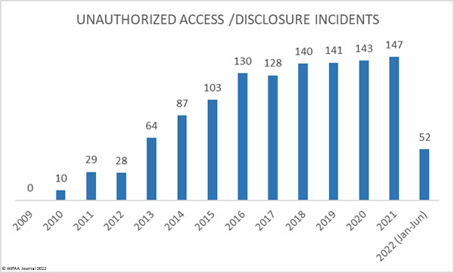
Recent Damage
Source: HIPAA Journal

Slide 5
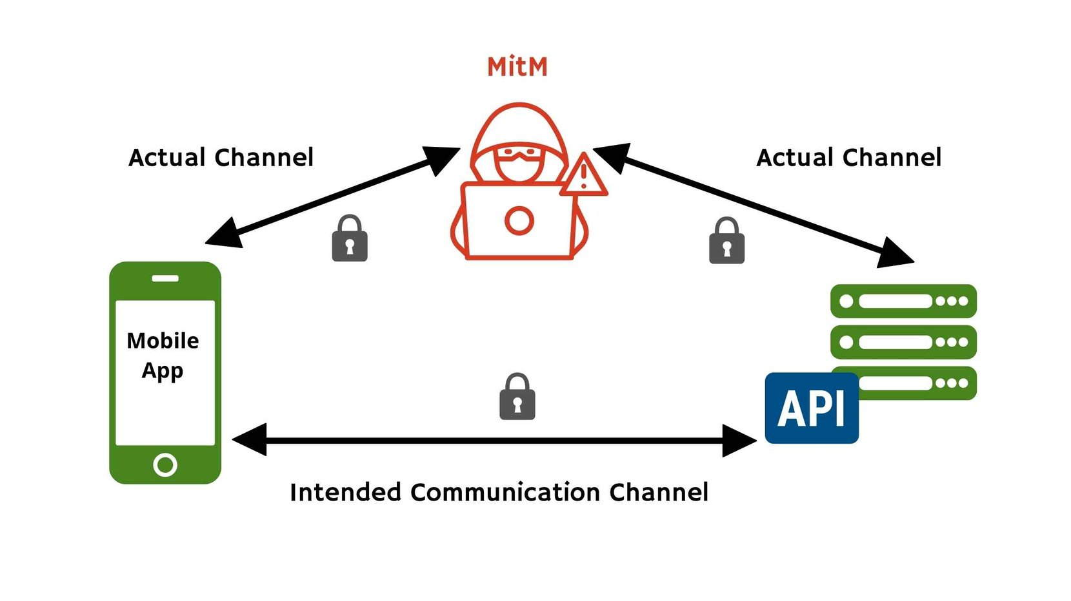
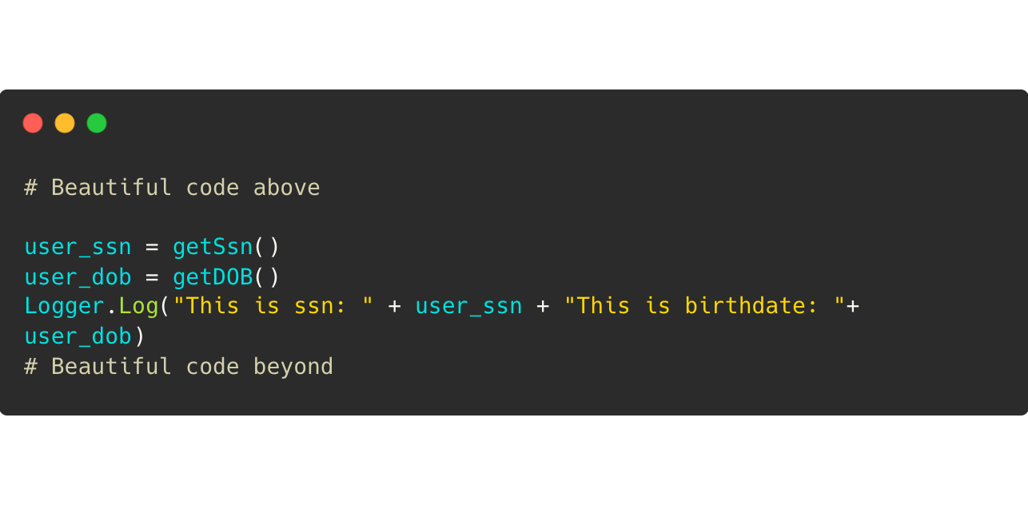
How data leaks
Uploading data insecurely to cloud
Using insecure web clients
Insecure ports
Source: approov.io
Logging Secure Data
Phishing attempt by Apps

Slide 6


We have done something unexpected
Maybe photoshop it?
Can we do this when an app compromises data?

Slide 7
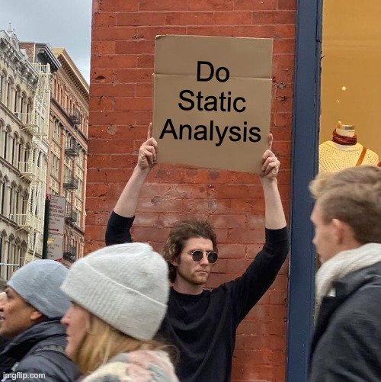
Before you get hit

Slide 8
Static Analysis - Taint - FlowDroid
→ Decompile the APK (Application Package)
→ Analyze the flow from Manifest+XML
→ Build Call graph using IFDS inter-procedural, finite, distributive, subset
→ Taint Analysis from Source to Sinks
→ Out of the box tool FlowDroid

Slide 9
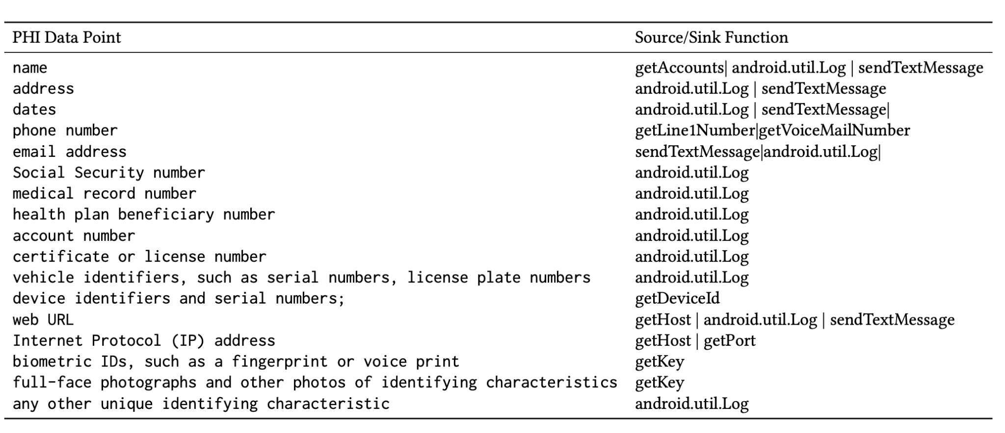
PHI Mapping With Source/Sinks

Slide 10
Our Study
→ Analyze the application leakage
→ Empirically check the False Positives
→ Check the intent of developers
→ Analyze the possible exploit of Attacker
→ Determine relationships of Intents
→ Propose the countermeasure

Slide 11
What are we doing now
Prepared A dataset of 50 Apps and counting
We are analyzing using FlowDroid on every app
Store leakage and processed flow data
Determine relationship with leaks
What is the developer intent?
What is the Attacker Intent?

Slide 12
Example
“Universal Remote Control” - 10M Downloads
News says it has leakage
We found leakage in Location data
Wait what? Why it is leaking that data?
May be a mistake/Disguised Malware Developer Intent
An attacker exploit users location Attacker Exploit

Slide 13
Finally
→ Dataset with application insights and patterns
→ Empirically defined intent specifications
→ Data for future research
→ Data will help users and regulatory bodies too.

